Slide 1
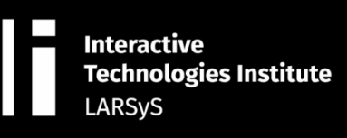








MADEIRA INTERNATIONAL WORKSHOP IN MACHINE LEARNING
2021

Slide 2
Convolutional neural network

Slide 3
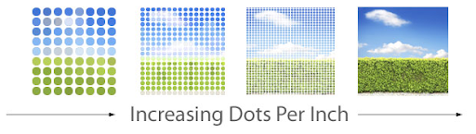
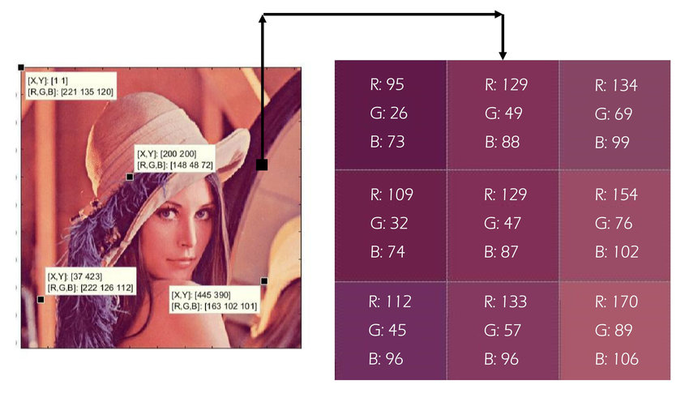
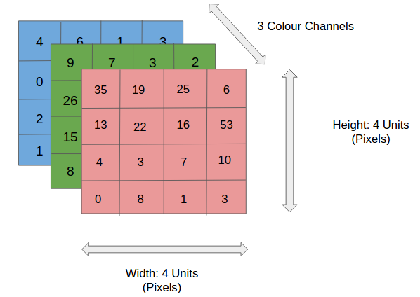
Image

Slide 4
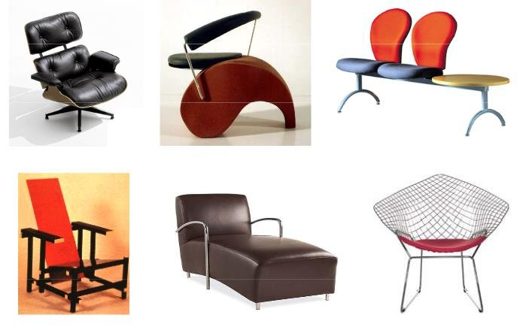
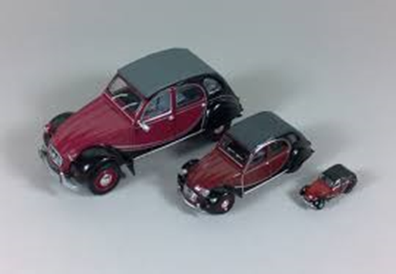
Problems with Images
Intra-Class Variation: variation between the images of same class
Scale Variation: image of same object with multiple size

Slide 5
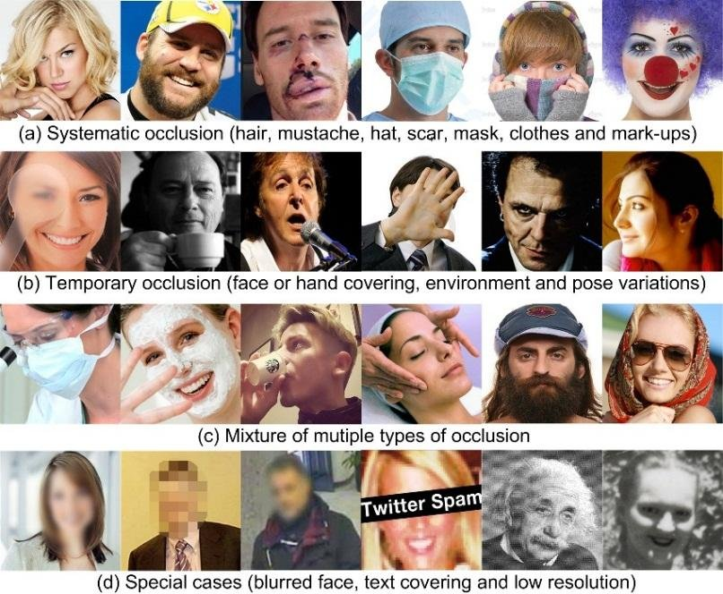
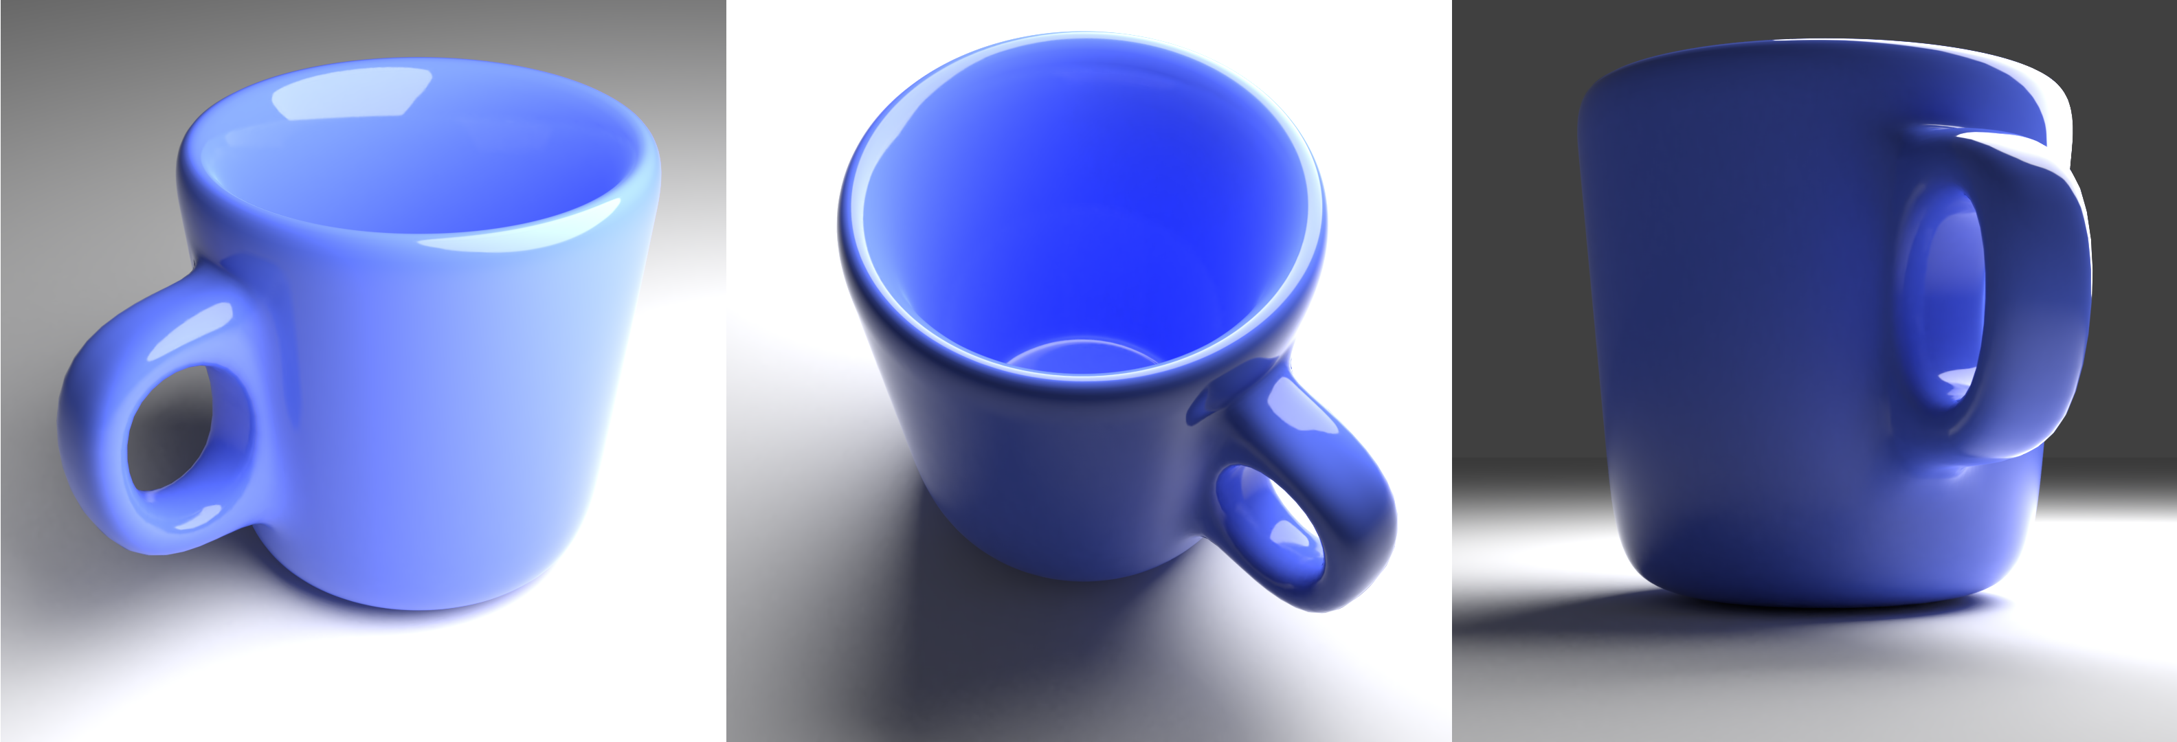
Problems with Images
View-Point Variation: an object can be oriented/rotated in multiple dimensions
Occlusion: can not be view completely.

Slide 6
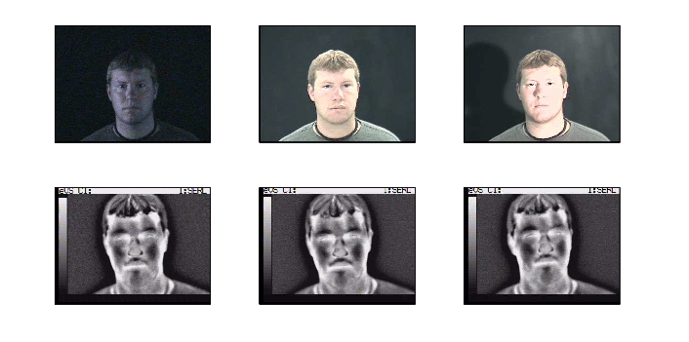
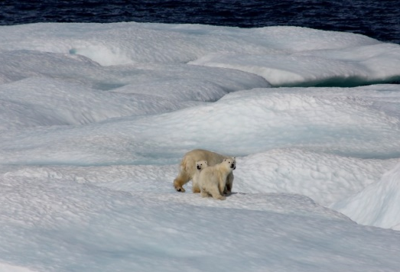
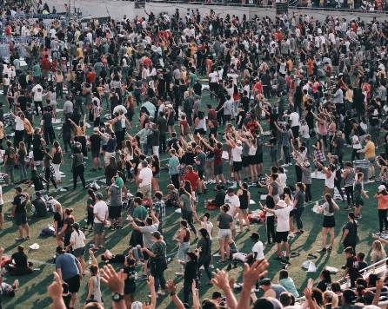
Problems with Images
Illumination: changes in Illumination.
Background Clutter: a lot of objects, a lot of objects

Slide 7
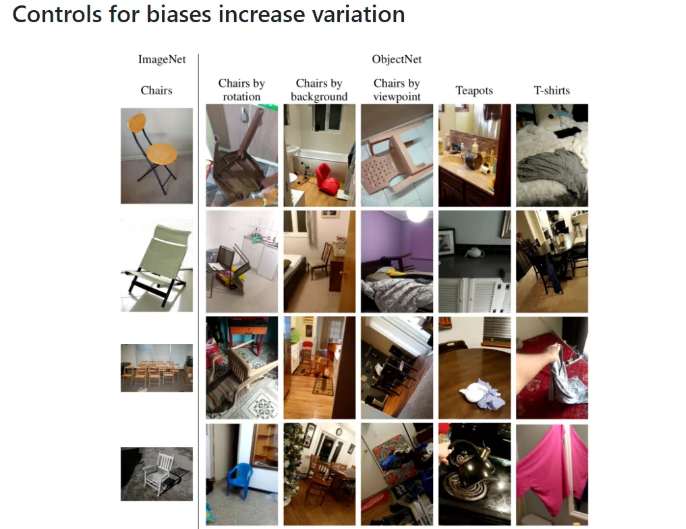
Problems with Images

Slide 8
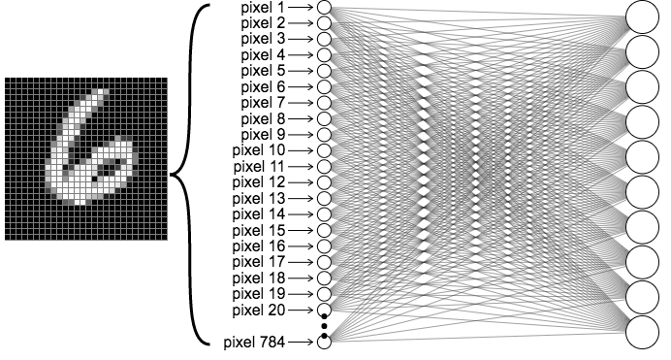
ANN FC

Slide 9
Convolutional neural network
Convolutional Layer
Pooling Layer
Activation layer (dense layer, fully connected layer)

Slide 10
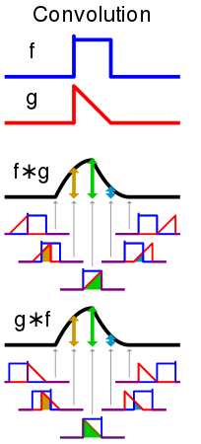
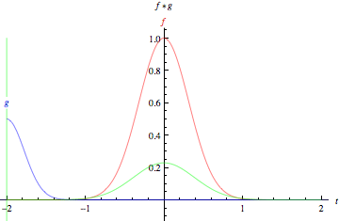

Convolutional Layer

Slide 11
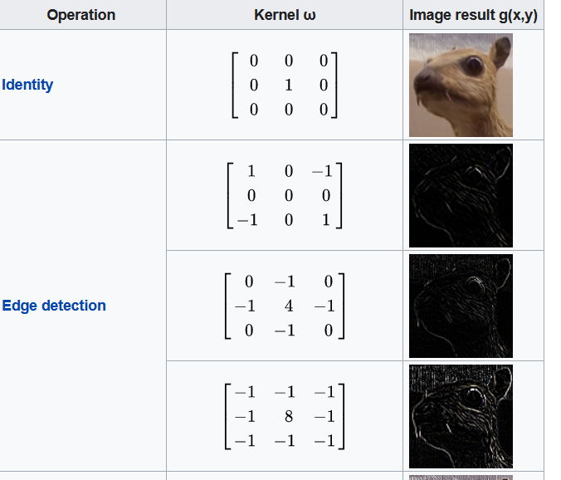
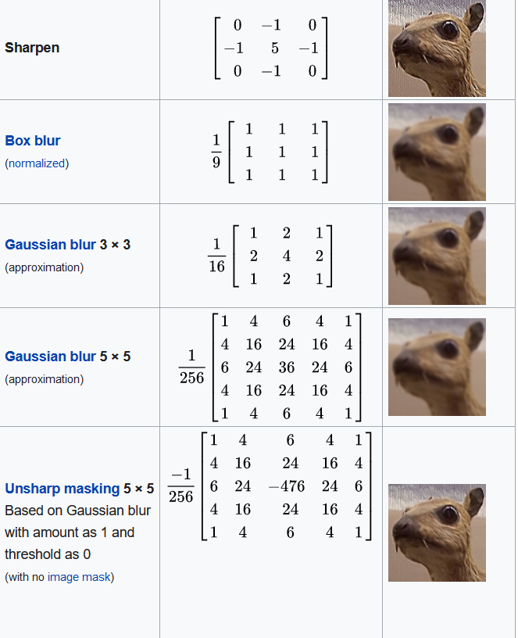
Convolutional Layer
https://en.wikipedia.org/wiki/Kernel_(image_processing)

Slide 12

Convolutional Layer

Slide 13

Convolutional Layer

Slide 14

Pooling layer
Max-pooling
Avg-pooling

Slide 15
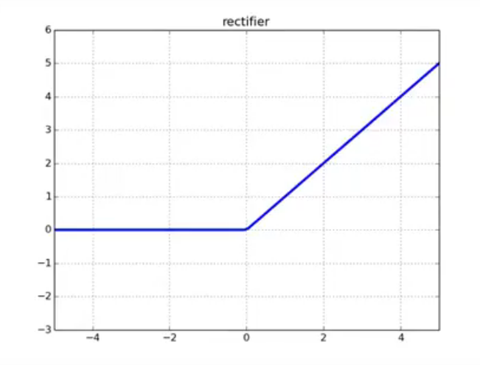

Activation layer
$$f\left(x\right)=\{\begin{matrix}0, x<0 \\ x, x≥0\end{matrix}$$

Slide 16
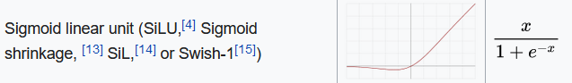
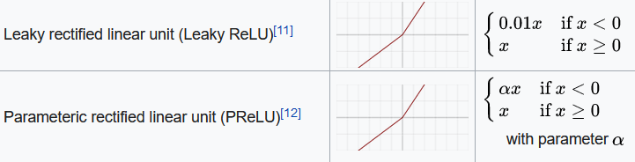
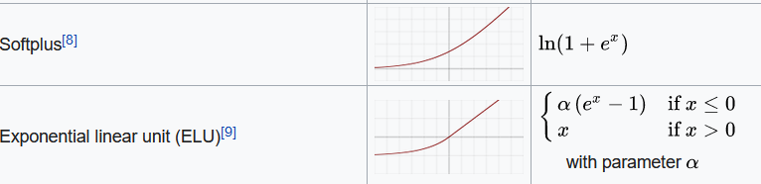
Activation layer
https://en.wikipedia.org/wiki/Activation_function

Slide 17
Thank You

